Slide 1
Making the Internet Secure
James Stumme
Pillar Technology
jstumme@pillartechnology.com
https://github.com/stummej

Slide 2
Pros
Provides secure communications between client and server
User and password login information
Credit card information
Personally identifiable information (PII)
Provides identity assurance
Content, data, and images are coming from the real server
Reduces man-in-the-middle attacks*
* Some companies employ SSL/TLS proxy servers that intercept all traffic and resign with their CA. Will still be invalid if their CA cert is not installed.

Slide 3
Cons
Requires more resources
Requires all content to be over SSL/TLS
Breaks proxy caching
Usually requires manual verification and re-configuration
Usually an annual cost associated

Slide 4
Levels of Validation/Assurance
 | Domain Validated | Company Name Validated | Address Validated | Pad Lock Displayed | Green Address Bar | Typical Cost
DV | X |  |  | X |  | $
OV | X | X | X | X |  | $$
EV | X | X | X | X | X | $$$
Domain Validation (DV) Organization Validation (OV) Extended Validation (EV) * Table from https://casecurity.org/2013/08/07/what-are-the-different-types-of-ssl-certificates/

Slide 5
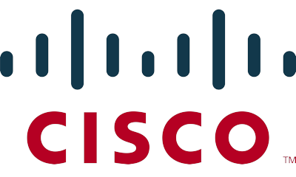








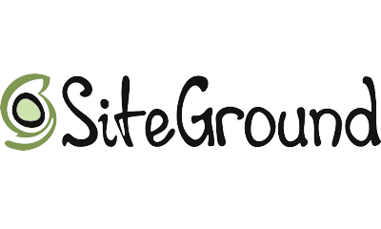










by the Internet Security Research Group
* Logos from https://letsencrypt.org

Slide 6
Mission and Principles
Mission:
Encryption by default on the web
Principles:
Free certificates
Automated domain verification and renewal
Security best practices
Transparent issuing and revoking of certificates
Open source (on github)
Pros
Free certificates
Easy request and renewal
Cons
90 day certificates
Domain Validation

Slide 7
Ways to Configure SSL/TLS
Reverse Proxy
Site Configuration

Slide 8
Reverse Proxy
Pros
Easy to secure third party daemons (Jenkins, Blackduck, etc…)
Provides loadbalancing
Provides rewrite rules to force SSL/TLS
Unified certificate configuration
Cons
Can become a bottle-neck
Requires extra resources

Slide 9
Reverse Proxy Configuration (NGINX)
server {
listen 80;
server_name www.site.com;
rewrite ^ https://$server_name$request_uri? permanent;
}
server {
listen 443 ssl http2;
server_name www.site.com;
ssl_certificate /etc/letsencrypt/live/www.site.com/fullchain.pem;
ssl_certificate_key /etc/letsencrypt/live/www.site.com/privkey.pem;
ssl_trusted_certificate /etc/letsencrypt/live/www.site.com/chain.pem;
ssl_session_timeout 60m;
ssl_protocols TLSv1.1 TLSv1.2;
resolver 8.8.8.8 8.8.4.4 valid=86400;
resolver_timeout 10;
location /.well-known { alias /var/letsencrypt/.well-known/; }
location / {
proxy_set_header Host $host;
proxy_set_header X-Real-IP $remote_addr;
proxy_set_header X-Forwarded-For $proxy_add_x_forwarded_for;
proxy_set_header X-Forwarded-Proto $scheme;
proxy_redirect http:// https://;
add_header Pragma "no-cache";
proxy_pass https://127.0.0.1:8080;
}
}
Forces visitor to SSL/TLS site
Encryption Keys
Forces supported protocols
Allows reverse proxy to update short lived certificates
Reverse proxy to real server/service

